Slide 1



TO STUDY THE IMPORTANCE OF PORTFOLIO ANALYSIS AND INVESTING CHOICES IN DELHI NCR
SUBMITTED BY: ABHISHEK PANDEY
CLASS: EVENING B
ENROLLMENT NO.: 00580301720
MENTOR: SUNAKSHI MAHAJAN

Slide 2
INTRODUCTION
Portfolio analysis is a technique used to evaluate the performance of an investment portfolio.
- It involves examining the holdings of the portfolio, assessing their risk and return characteristics, and determining how they fit together to achieve the investor's goals.
- Investing choices refer to the different types of investments that are available to investors, such as stocks, bonds, mutual funds, and real estate.
- The importance of portfolio analysis and investing choices lies in their ability to help investors make informed decisions about their investments, manage risk, and achieve their financial goals.
- This project aims to study the importance of portfolio analysis and investing choices in Delhi NCR, specifically by examining the investment behavior of individual investors in the region and assessing the effectiveness of different portfolio analysis techniques in helping them achieve their investment objectives.

Slide 3
LITERATURE REVIEW
Brown et al(2022)- This study looks at how employees' ability to choose from a variety of investments under defined contribution plans affects their portfolio decisions. First, we demonstrate that aggregate participant portfolio allocations across various asset classes are significantly influenced by the proportion of investment options available in a given asset class (i.e., company stock, stocks, fixed income, and balanced funds). Second, we provide evidence that high-cost actively managed equities funds, rather than equity index funds with lower costs, make up the great majority of new funds added to 401(k) plans. Third, average portfolio expenses rise and average portfolio performance is therefore decreased as the average share of assets invested in low-cost stock index funds decreases as the number of options increases.
Pavolova et al(2021)- When investing money, everyone's primary objective is to make a profit. The research in this work are intended to study various models and help investors reach their aims of maximising investment and minimising risk. A systematic, long-term practise called investing involves the investor giving up some of his free money in exchange for the potential to enhance that money's worth and earn a return. Only when certain guidelines are followed can investing be beneficial
Brandstetter and Lehner(2020):- impact on society and the environment Both investing as a practise and as an idea have gained popularity on a genuinely global scale. However, aside from sporadic instances of some specialised kinds, such social-impact bonds, little is understood about the subject and the intricate interactions between actors, tools, and rules. The justifications of the various players in the area and the evaluation standards for some of its instruments haven't been thoroughly examined yet. 10. Jappelli and Padula(2020):- We provide a consumer investment in financial literacy intertemporal consumption model. Because they may raise the returns on their wealth thanks to their stock of financial literacy, consumers gain from such investments. Since literacy costs money and deteriorates over time, The methodology calculates the best investment in literacy based on current spending. The model demonstrates a positive life-cycle correlation between financial literacy and wealth that is determined jointly.

Slide 4
4. Guiso and Jappeli(2019):- In this essay, we emphasise the lack of financial knowledge as one possible explanation for the lack of portfolio diversification. We make use of the 2007 Unicredit Customers' Survey, which contains data on investor demographics, financial literacy, and markers of portfolio choice. We first provide test-based measures of financial literacy and quantify the degree of under-diversification in portfolios.
5. Aren and hamamci(2019)- This study intends to evaluate how risk aversion, risky investment intention, and investment choices are affected by subjective and financial literacy, the big five personality traits, and emotions (fear, anger, hope, and sadness). These three variables—risk aversion, desire to make hazardous investments, and investment preferences—and their interactions were also looked at.
6. Alexandrovich et al(2019)- In order to solve the issues of making portfolio decisions, the use of an econometric model with a discrete dependent variable is examined. A diagonal portfolio investment model is built using the Wiener regression as a foundation, and it was through its calculations that the interpretation of the yield-risk relationship could be made clear. As a result, the yield of any financial asset traded on the market is influenced by the market's investment potential. In conclusion, the predicted degree of profitability will deviate more from the amount promised by the market's investment potential the higher the risk

Slide 5
COMPANY PROFILE
NEED OF THE STUDY
“To study the importance of portfolio analysis and investing choices in Delhi NCR”
The title of my project is “To study the importance of portfolio analysis and investing choices in Delhi NCR”. The purpose of this research paper is to explore the process of evaluating a portfolio and making investment decisions. The paper will examine the importance of defining investment goals, conducting regular portfolio reviews, diversifying investments, conducting fundamental and technical analysis, and considering macroeconomic factors in the investment decision-making process. The paper will also highlight the benefits of taking a systematic approach to evaluating a portfolio and making investment decisions, including maximizing returns, managing risk, and achieving investment goals.
The paper will draw on existing research and literature on portfolio evaluation and investment decision-making, including academic studies, industry reports, and expert opinions. The research will also include practical examples and case studies to illustrate the key concepts and strategies for evaluating a portfolio and making investment decisions.
The research paper is intended for investors, financial professionals, and anyone interested in learning more about portfolio evaluation and investment decision-making. The paper aims to provide a comprehensive overview of the investment decision-making process, highlighting best practices and strategies for maximizing returns and managing risk in a dynamic and ever-changing market environment

Slide 6
RESEARCH METHODOLOGY
1. Objectives
To explore the investment patterns of individuals in Delhi NCR.
To study the portfolio evaluation and related investment decisions.
2. Research Design
The study is solely descriptive in nature, with the goal of understanding how to evaluate portfolio and make investment decisions. This is a purely theoretical study approach in which the researcher gets data, analyses it, prepares it, and then delivers it in an understandable manner.
3. Sources of data
The primary data for this study will be collected through semi-structured interviews with investment professionals and individuals with experience in managing investment portfolios. The interviews will be conducted using a predetermined set of open-ended questions designed to gather insights into the process of evaluating a portfolio and making investment decisions.
4. Sample of study
I am taking sample of investment professionals and individuals with experience in managing investment portfolios in Delhi NCR.
5. Time period of study
The research is conducted between the time period of February to June.
6. Tools and Techniques
Descriptive statistics tool will be employed.

Slide 7
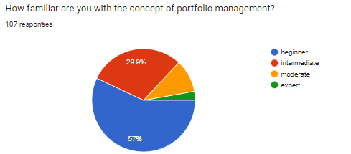
ANALYSIS
Q1.
Interpretation: As per the above data, majority of respondents are just beginners as they have just started investing and followed by 29.9% intermediate, 10.3% are modern and remaining 2.8% are expert in concepts of portfolio management and investing.

Slide 8
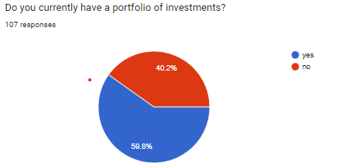
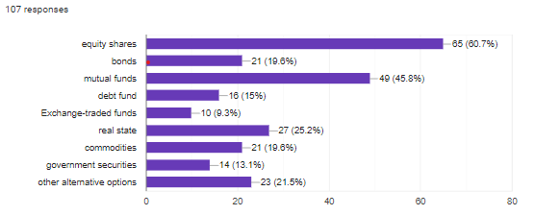
Q2.
Interpretation: As per the above data, 59.8% respondents have portfolio of investing and 40.2% don’t have.
Q3. If yes, what types of investments are in your portfolio?
Interpretation: As per the above data our of 107 people - 65 people invest in equity shares,49 invest in mutual funds,27 invest in real estate,23 in other alternative options,21 invest in commodities,21 invest in bonds,16 invest in debt bonds,14 invest in govt securities and 10 invest in ETFs.

Slide 9
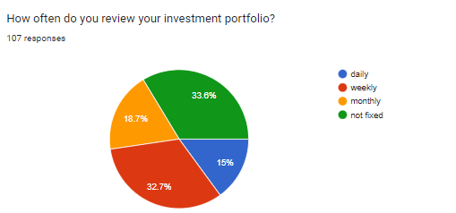
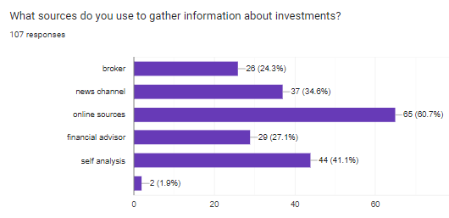
Q 4.
Interpretation :-As per the above data 15% people reviewed their investment daily,19 % people reviewed monthly,33 % people reviewed weekly and 33% people were not fixed.
Q-5
Interpretation ;- As per the above data out of 107 people collect information ,65 people from online sources, 44 from self analysis, 37 from news channel, 29 from financial advisor, 26 people from broker and 2 people from other sources.

Slide 10
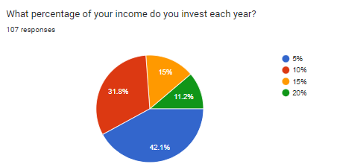
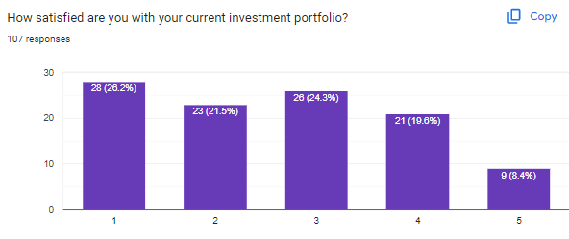
Q-6
Interpretation:- As per the above data 42 % of people invest 5% of their total income, 32 % of people invest 10% of their total income, 15 % of people invest 15% of their total income and 11 % of people invest 20% of their total income.
Q- 7
Interpretation :- As per the above data people rate their current investment portfolio as 26% rated 1, 24% rated 3, 21% rated 2 and 20% rated 4 and 8% rated 5.

Slide 11
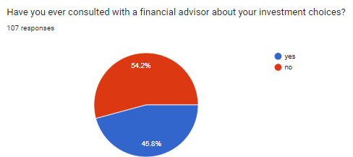
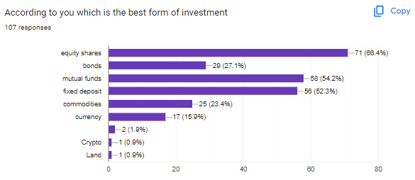
Q-7
Interpretation:- As per the above data 54 % of people says yes that they have consulted with financial advisor about their investment and 46% people says not.
Q- 14
Interpretation :- As per the above out of 107 people 71 people invest in equity shares, 58 people in mutual funds, 56 people in FDs, 29 people in bonds, 25 people in commodities, 17 people in currency,1 in crypto-currency, 1 in land and 2 people in other.

Slide 12
FINDINGS AND CONCLUSION
Findings-
1. Risk tolerance: Investors should assess their risk tolerance, which is the level of uncertainty they are willing to accept in their investments. This evaluation helps determine the appropriate asset allocation and investment strategy.
2. Diversification: Diversifying a portfolio across different asset classes (e.g., stocks, bonds, real estate) can help reduce risk. By spreading investments across various sectors and industries, the impact of a single investment's performance is minimized.
3. Investment goals: Clearly defining investment goals is crucial. Whether the objective is long-term wealth accumulation, income generation, or capital preservation, investment decisions should align with these goals.
4. Fundamental analysis: Conducting fundamental analysis involves assessing the financial health, performance, and prospects of individual securities. Factors such as earnings growth, valuation, competitive positioning, and industry trends are considered to evaluate the investment potential of a company.
5. Technical analysis: Technical analysis involves studying past price and volume patterns to identify trends and make predictions about future price movements. Technical indicators and chart patterns are used to assist in investment decision-making.
6. Market research: Staying informed about the market conditions, economic trends, and regulatory environment is essential. Monitoring news, industry reports, and economic indicators can provide valuable insights for investment decisions.
7. Performance evaluation: Regularly reviewing the performance of investments is crucial. This assessment involves comparing portfolio returns against benchmarks, analyzing risk-adjusted returns, and identifying underperforming assets for potential adjustments.

Slide 13
Conclusion
To study the importance of portfolio analysis and investing choices in Delhi NCR requires a comprehensive understanding of various factors and considerations. The findings suggest that investors in the region should carefully assess their risk tolerance and investment goals to determine an appropriate asset allocation strategy.
Diversification emerges as a crucial element in portfolio evaluation, as spreading investments across different asset classes and sectors can help mitigate risk and enhance potential returns. By avoiding overexposure to a single security or industry, investors can reduce the impact of market fluctuations on their portfolio performance.
Fundamental analysis plays a significant role in evaluating individual securities. By assessing the financial health, performance, and prospects of companies operating in Delhi NCR, investors can make informed decisions about their inclusion in the portfolio. Factors such as earnings growth, valuation, competitive positioning, and industry trends should be thoroughly examined.
Additionally, incorporating technical analysis techniques can provide further insights into price trends and potential entry or exit points. Monitoring market conditions, economic indicators, and regulatory developments specific to Delhi NCR is essential for making informed investment decisions.
Regular performance evaluation is crucial to track the progress of the portfolio and identify areas for adjustments or rebalancing. Comparing portfolio returns against relevant benchmarks and considering risk-adjusted returns helps investors gauge the effectiveness of their investment strategies.
In conclusion, to study the importance of portfolio analysis and investing choices in Delhi NCR necessitates a well-rounded approach that encompasses risk assessment, diversification, fundamental and technical analysis, market research, and performance evaluation. By employing a systematic and informed investment approach, investors can enhance their chances of achieving their financial goals in the context of the Delhi NCR region.

Slide 14
REFERENCES
1. Aouni, B., Doumpos, M., Pérez-Gladish, B., & Steuer, R. E. (2018). On the increasing importance of multiple criteria decision aid methods for portfolio selection. Journal of the Operational Research Society, 69(10), 1525-1542.
2. Khan, M. Z. U. (2018). Impact of availability bias and loss aversion bias on investment decision making, moderating role of risk perception. Management & Administration (IMPACT: JMDGMA), 1(1), 17-28.
3. Lyandres, E., Matveyev, E., & Zhdanov, A. (2018). Misvaluation of investment options. working paper.
4. Adil, M., Singh, Y., & Ansari, M. S. (2022). How financial literacy moderate the association between behaviour biases and investment decision?. Asian Journal of Accounting Research, 7(1), 17-30.
5. Pavolova, H., BAKALÁR, T., KYŠEĽA, K., Klimek, M., Hajduova, Z., & Zawada, M. (2021). The analysis of investment into industries based on portfolio managers. Acta Montanistica Slovaca, 26(1).
6. Adner, R., & Feiler, D. (2019). Interdependence, perception, and investment choices: An experimental approach to decision making in innovation ecosystems. Organization science, 30(1), 109-125.
7. Aren, S., & Hamamci, H. N. (2020). Relationship between risk aversion, risky investment intention, investment choices: Impact of personality traits and emotion. Kybernetes, 49(11), 2651-2682.
8. Alexandrovich, E. D., Vladimirovich, D. V., & Valeryevna, D. M. (2019). A new approach to modeling and analysis portfolio investment solutions. Opción: Revista de Ciencias Humanas y Sociales, (24), 420-440.

Slide 15
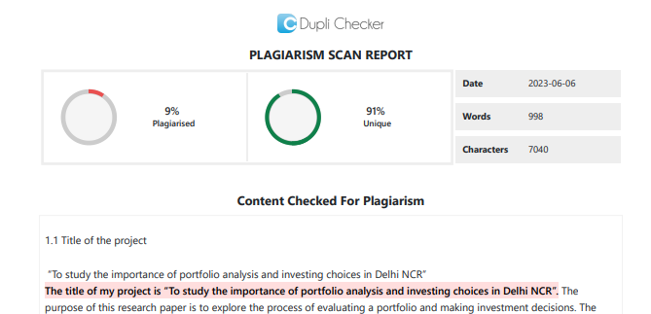
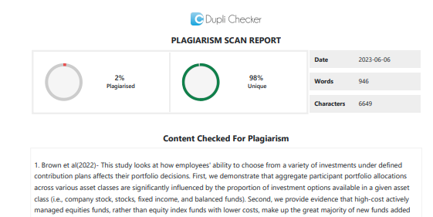
PLAGIARISM REPORT

Slide 16
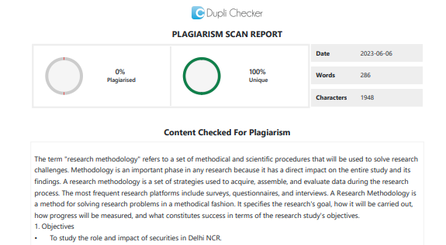
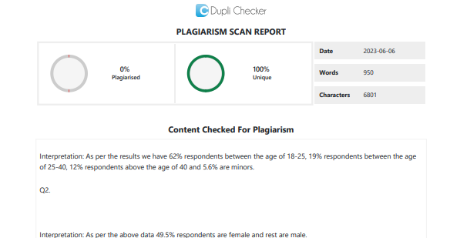

Slide 17


